Slide 1
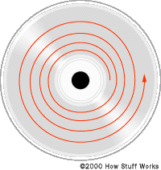
Optical Memory - Compact Disk (CD)
Question: Draw the internal organization of a compact disk (CD) and discuss
how data is read from it.
Answer:
Figure: Tracks of CD

Slide 2
Discussion of Block Diagram:
A CD is made by special type of plastic material called polycarbonate plastic. The plastic material is cut in circular form to make disk plate. Then a thin layer of aluminum coating is given over the plate. Only one surface of a plate is used to store data. Data are stored on a spiral track. The spiral track is divided into different sectors. Sectors are numbered from inside to outside. The plate is rotated by a motor and data read-write operation is taken place.
Data Read Operation:
To read any data from a CD, an operating system needs to know the actual address or location of the data in the disk by reading File Allocation Table (FAT). An address can be associated only with the sector numbers.

Slide 3
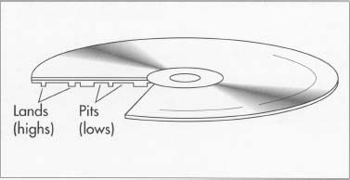
Lands and Pits
Land : Reflects sufficient light and indicate a high or logic 1.
Pit : Does not reflect sufficient light and indicate a low or logic 0.

Slide 4
Data Reading Mechanism of a CD
rotation
rotation
Land
Land
Pit
Pit
Prism
Prism
Sensor
Sensor
Laser Source
Laser Source
Figure: Data Read Operation of a CD.

Slide 5
Discussion:
To read any data a beam of laser light is thrown from a laser source. The laser beam is passed through a prism to guide it on right track. When the beam is fallen on the surface of the CD it can either reflect or scattered into different angles. If the fallen place is concave (meaning a land), then the beam is reflected straight back to the prism. The direction of the reflected beam is navigated through the prism and sent to a sensor. The sensor then sense the intensity of light and make decision it as a land (high) and a voltage for logic 1 is sent to the data bus.
For a pit, the fallen laser beam is scattered into different angles and there is no reflected light to the prism. So, the sensor does not sense any reflected light, it means the absence of a land bit. That is, a pit (low) is read and a voltage for logic 0 is sent to the data bus.

